Slide 1
CENG-232 Logic Design
Sequential Circuit Design Examples
And State Reduction

Slide 2
Last time
We designed a sequence recognizer
The output is set to 1 when the desired pattern is found, otherwise it is 0.
In our example, the desired pattern “1001”.
Example input, output:
Input: 1 1 1 0 0 1 1 0 1 0 0 1 0 0 1 1 0 …
Output: 0 0 0 0 0 1 0 0 0 0 0 1 0 0 1 0 0 …

Slide 3
Step 1: State table
0/0
1/0
1/0
0/0
0/0
A
B
C
D
1/0
0/0
1/1

Slide 4
Step 2: Assigning binary codes to states

Slide 5
Step 3: Finding flip-flop inputs
?

Slide 6
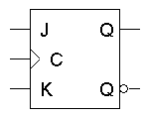
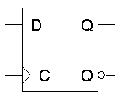
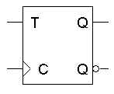
Excitation Tables for all flip-flops

Slide 7
Step 3 continued
Use K-map to find minimal expressions for J and Ks

Slide 8
Step 4: Find FF in/out equations
J1 = X’ Q0
K1 = X + Q0
J0 = X + Q1
K0 = X’
Z = Q1Q0X

Slide 9
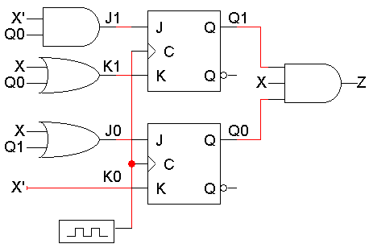
Step 5: Build the Circuit
Lastly, we use these simplified equations to build the completed circuit.
J₁ = X’ Q₀
K₁ = X + Q₀
J₀ = X + Q₁
K₀ = X’
Z = Q₁Q₀X

Slide 10
Summary of sequential Circuit Design
1) Make a state table and, if desired, a state diagram. This step is usually the hardest.
2) Assign binary codes to the states if you didn’t already. Unused states can be treated as don’t care conditions.
3) Use the present states, next states, and flip-flop excitation tables to find the flip-flop input values.
4) Write simplified equations for the flip-flop inputs and outputs and build the circuit.

Slide 11

Exercise 1
Draw the timing diagram of the sequence recognizer for input X=1001. Assume the initial states of flip-flops to be zeros.

Slide 12
Timing Diagram
Here is one example timing diagram for our sequence detector.
The flip-flops Q1Q0 start in the initial state, 00.
On the first three positive clock edges, X is 1, 0, and 0. These inputs cause Q1Q0 to change, so after the third edge Q1Q0 = 11.
Then when X=1, Z becomes 1 also, meaning that 1001 was found.
The output Z does not have to change at positive clock edges. Instead, it may change whenever X changes, since Z = Q1Q0X.
1 2 3 4
CLK
Q₁
Q₀
X
Z

Slide 13
Exercise 2
Change the JK flip-flops with D flip flops

Slide 14
Using D flip-flops
We already have the state table and state assignments, so we can just start from Step 3, finding the flip-flop input values.
D flip-flops have only one input, so our table only needs two columns for D1 and D0.

Slide 15
D flip-flop input values (Step 3)
The D excitation table is pretty simple; set the D input to whatever the next state should be.
You don’t even need to show separate columns for D1 and D0; you can just use the Next State columns.
The same

Slide 16
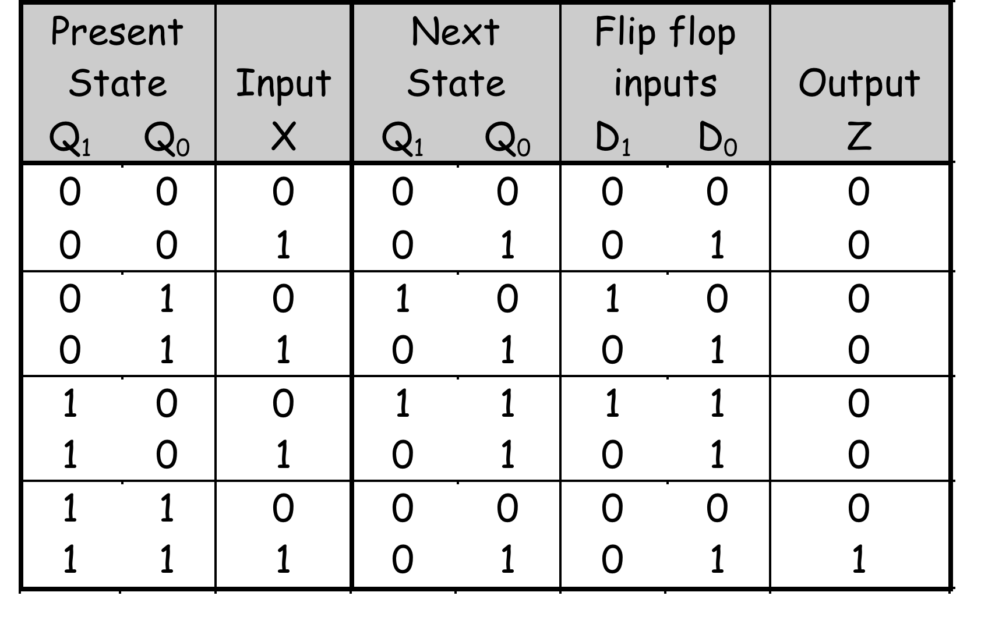
Finding Equations (Step 4)
You can do K-maps again, to find:
D1 = Q1 Q0’ X’ + Q1’ Q0 X’
D0 = X + Q1 Q0’
Z = Q1 Q0 X

Slide 17
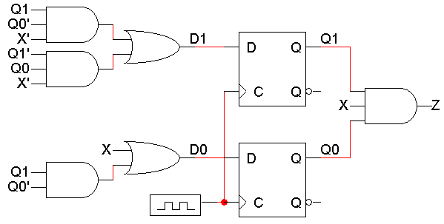
Sequence Recognizer with D FFs

Slide 18
Flip-flop comparison
JK flip-flops are good because there are many don’t care values in the flip-flop inputs, which can lead to a simpler circuit.
D flip-flops’ advantage: very simple excitation table since Q(t+1) = D. However, the D input equations are usually more complex than JK input equations
In practice, D flip-flops are used more often.
There is only one input for each flip-flop, not two.
There are no excitation tables to worry about.
D flip-flops can be implemented with slightly less hardware than JK flip-flops.

Slide 19
Design exercise
Design a sequential circuit that detects 01 patterns coming through an input line X. The circuit’s output Z should be set 1 when a 01 pattern occurs and to 0 otherwise.
Draw the state diagram of the circuit
Derive the state table
Implement using D-FF’s
Extend the state table for D-FF inputs
Derive the expressions for D-FF inputs
Draw the full circuit
X
01110001000010
01000001000010
Z

Slide 20

Remember the vending machine example?
Question: Design a digital circuit to control a vending machine which dispenses a chocolate bar for 75 cents.
Assume that the machine accepts 25 cent coins only.
The answer: a modulo-3 counter with enable and a MAX output.

Slide 21
Another exercise
Design a sequential circuit that outputs 1 if the most recent three input values have an odd number of 1s. Otherwise, the output is 0.

Slide 22
State reduction

Slide 23
State Reduction and Assignment
Goal: Reduce the number of states while keeping the external input-output requirements.
2^{m} states need m flip-flops, so reducing the states may reduce flip-flops.
If two states are equal, one can be removed but what are “equal states”?
State Equivalence

Slide 24
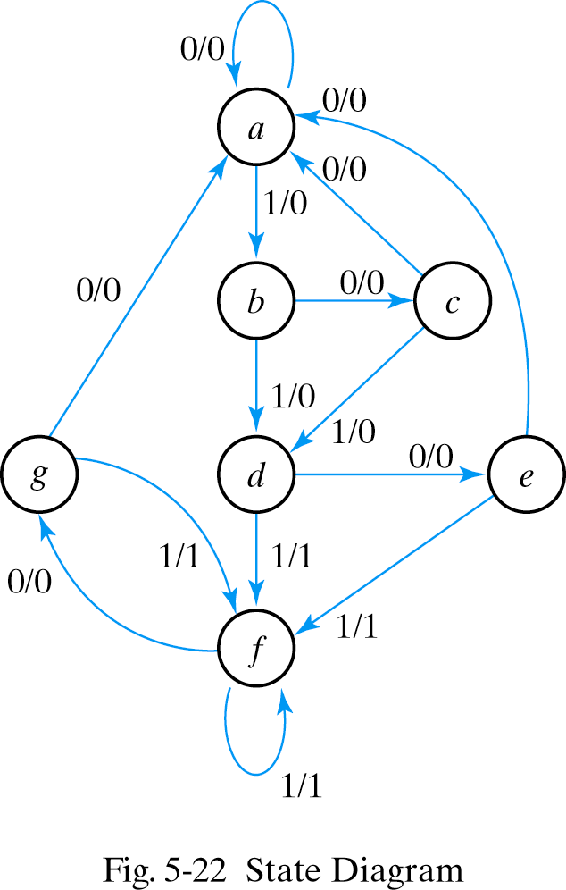
State Reduction Example
As an example consider the state diagram and the input sequence below:
“010101110100” applied and start from state a.
State a a b c d e f f g f g a
Input 0 1 0 1 0 1 1 0 1 0 0
Output 0 0 0 0 0 1 1 0 1 0 0

Slide 25
State Reduction Example
Present State Next State Output
x=0 x=1 x=0 x=1
a a b 0 0
b c d 0 0
c a d 0 0
d e f 0 1
e a f 0 1
f g f 0 1
g a f 0 1

Slide 26
State Reduction Example
Present State Next State Output
x=0 x=1 x=0 x=1
a a b 0 0
b c d 0 0
c a d 0 0
d e f 0 1
e a f 0 1
f g f 0 1
g a f 0 1
States e and g are equal since for each member of the set of inputs, they give the same output and send the circuit either to the same state or an equivalent state.

Slide 27
State Reduction Example
Present State Next State Output
x=0 x=1 x=0 x=1
a a b 0 0
b c d 0 0
c a d 0 0
d e f 0 1
e a f 0 1
f g e f 0 1
g a f 0 1
Table and state diagram after the first reduction: state g is removed and replaced by state e.

Slide 28
State Reduction Example
Present State Next State Output
x=0 x=1 x=0 x=1
a a b 0 0
b c d 0 0
c a d 0 0
d e f 0 1
e a f 0 1
f e f 0 1
g a f 0 1
Table and state diagram after the first reduction: g is removed and replaced by state e.
However, we now have NEW equal states: d and f

Slide 29
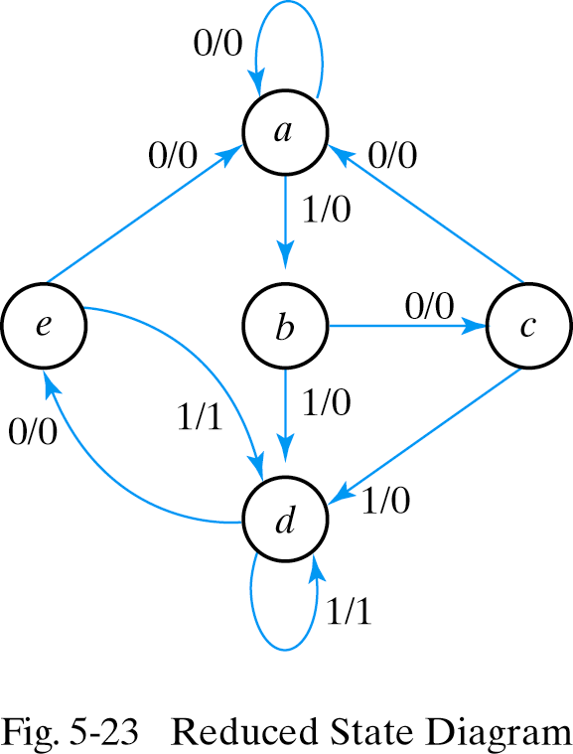
State Reduction Example
Present State Next State Output
x=0 x=1 x=0 x=1
a a b 0 0
b c d 0 0
c a d 0 0
d e d 0 1
e a d 0 1
f e f 0 1
g a f 0 1
Table and state diagram after the second reduction: f is removed and replaced by state d.
If we apply the same input sequence:
State a a b c d e d d e d e a
input 0 1 0 1 0 1 1 0 1 0 0
output 0 0 0 0 0 1 1 0 1 0 0

